Slide 1
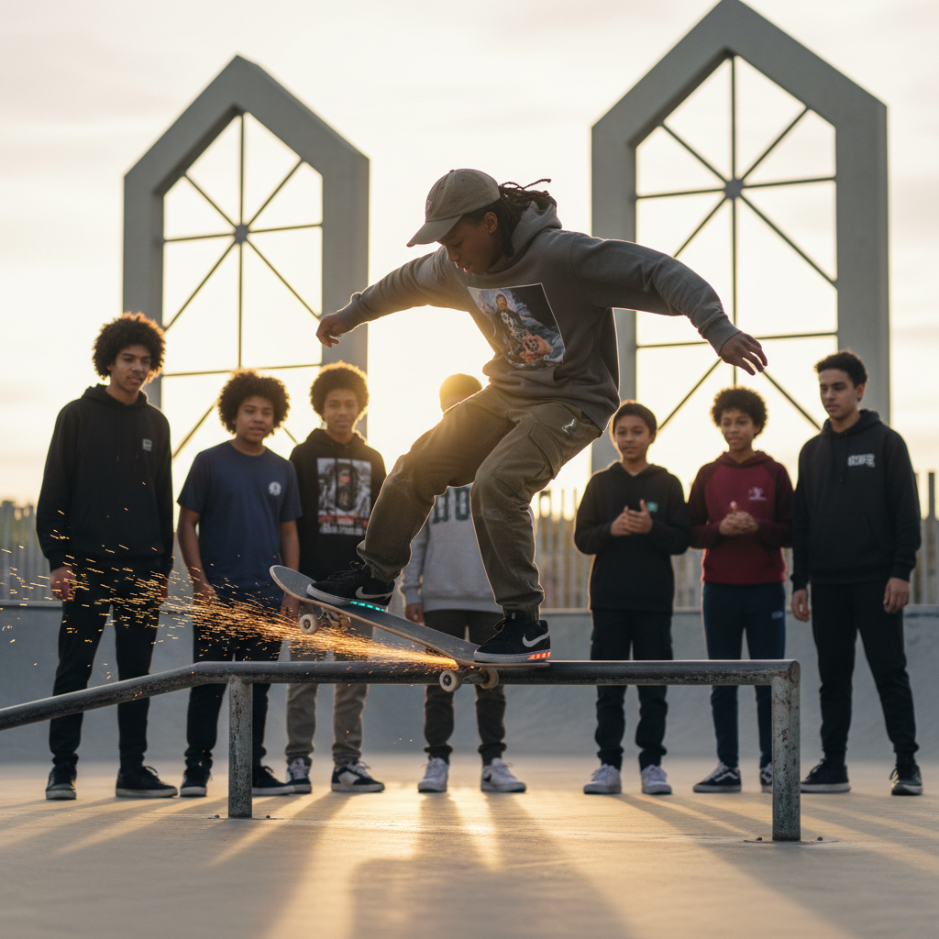
ModelIt!
Student Lesson
Why You Can't Slide Forever
The Hidden Energy Transfers That Stop Everything
NGSS: MS-PS3-5
7th Grade
1/9

Slide 2
What You Will Learn Today
Learning Goals
* Explain the relationship between speed, mass, and kinetic energy
* Model how friction transfers kinetic energy into thermal energy
* Predict how surface type affects the rate of energy transfer
* Construct arguments about energy conservation using model evidence
Key Vocabulary
Kinetic Energy
The energy an object has because of its motion — faster and heavier objects have more
Friction
A force between surfaces that opposes motion and converts kinetic energy into heat
Energy Transfer
The movement of energy from one object or system to another, or from one form to another
Thermal Energy
Heat energy — the total kinetic energy of all particles in a substance
2/9

Slide 3
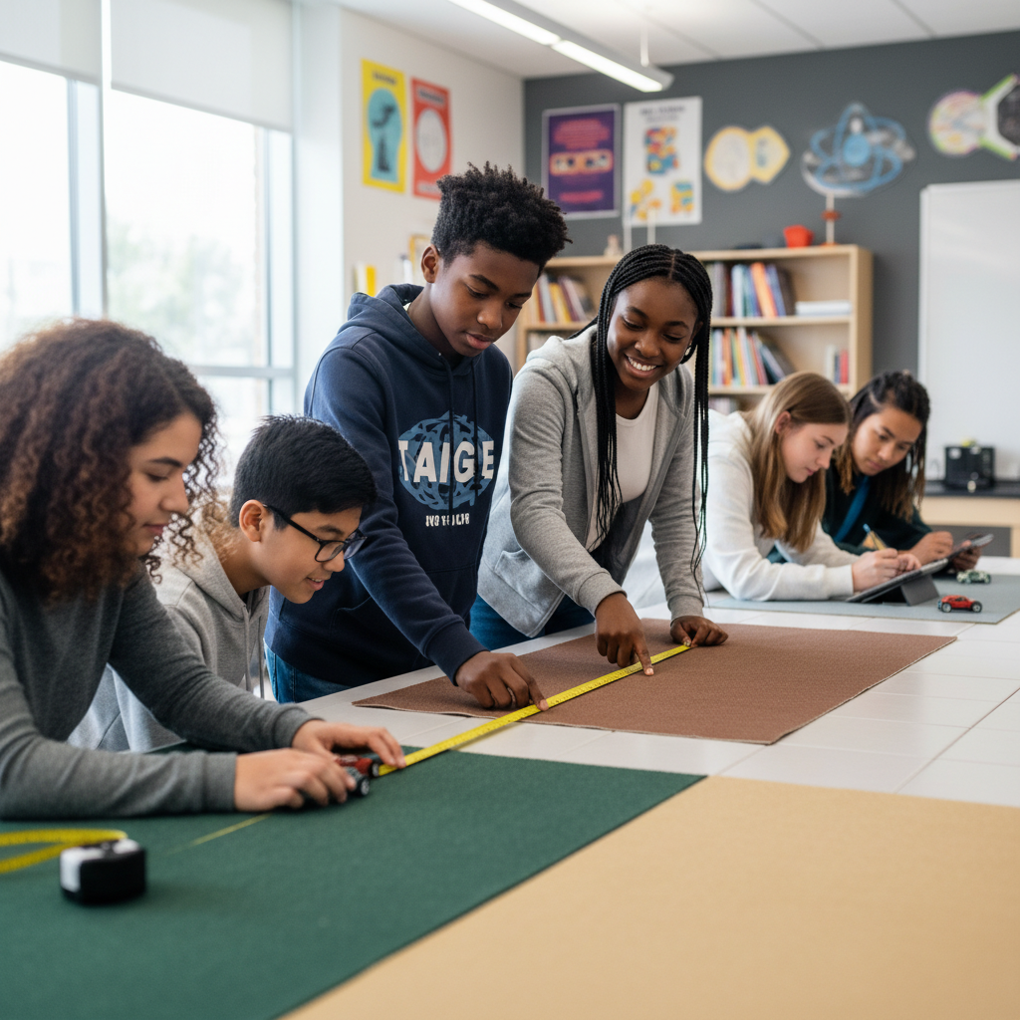
The Big Question
Why does every moving thing eventually stop — and where does the energy go?
The Hidden Energy Transfers That Stop Everything. Today we'll build a MODEL to discover the answer!
3/9

Slide 4
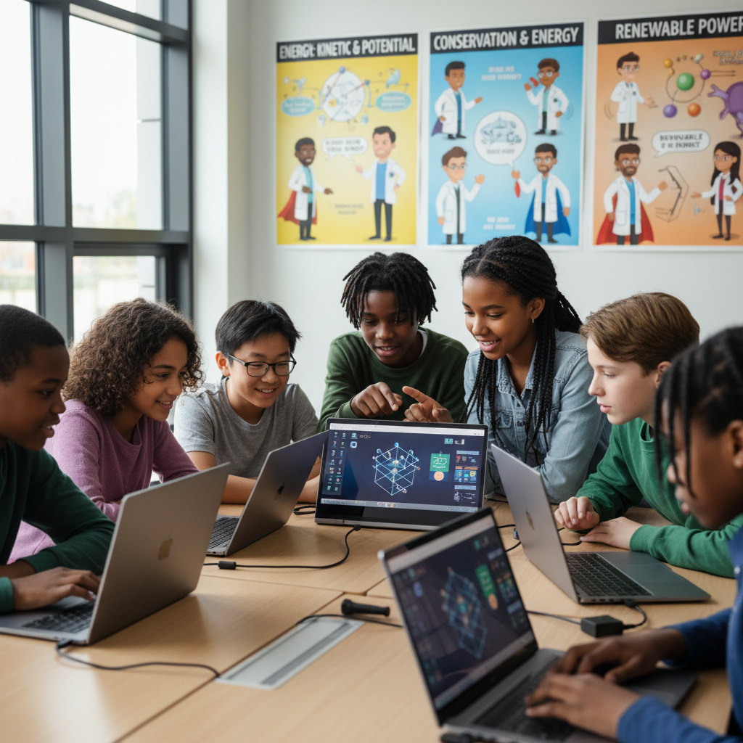
Today We Will Build a Model!
A model helps us understand complex systems!
1. LOCATE
Identify the COMPONENTS (parts) of the system
2. ESTABLISH
Connect them with RELATIONSHIPS (+ or -)
3. VISUALIZE
Build your model in ModelIt!
4. EVALUATE
Run SIMULATIONS to test scenarios
5. REVISE
Improve your model based on evidence
4/9

Slide 5

Activity 1: Sort the Components
Sort these components into EXTERNAL (inputs from outside) and INTERNAL (inside the system):
Your Components:
* Initial Speed
* Surface Friction
* Kinetic Energy
* Thermal Energy Output
Think: Which components can we control? Which happen on their own?
5/9

Slide 6
Activity 2: Connect with Arrows
Draw arrows to show HOW components affect each other:
(+) POSITIVE Relationship
When one goes UP, the other goes UP too
(-) NEGATIVE Relationship
When one goes UP, the other goes DOWN
Think About It:
When surface friction is very high, kinetic energy drops fast. But the total energy in the system hasn't changed — so where did it go?
6/9

Slide 7
Activity 3: Run the Simulation!
Test these scenarios in ModelIt!
Ice Surface
Set Surface Friction to very low (smooth ice) and observe how long kinetic energy lasts
Concrete Surface
Set Surface Friction to high and observe rapid energy transfer
Carpet Surface
Lock Surface Friction to maximum and observe the fastest energy conversion
Watch the activity graphs change!
[ModelIt Platform Screenshot - Simulation Results Graph]
7/9

Slide 8
What Did We Discover?
Our Model Showed Us:
* Energy is never created or destroyed — it only changes form (conservation of energy)
* Friction converts kinetic energy into thermal energy — that's why your hands get warm when you rub them
* Smoother surfaces mean less friction and slower energy conversion — objects slide farther
* Kinetic energy depends on speed SQUARED — doubling speed quadruples the energy
Answer: Nothing ever slides forever because friction converts kinetic energy (motion) into thermal energy (heat). The energy doesn't disappear — it transforms. Rub your hands together and feel the heat — that's kinetic energy becoming thermal energy right in your palms! Energy is always conserved.
8/9

Slide 9
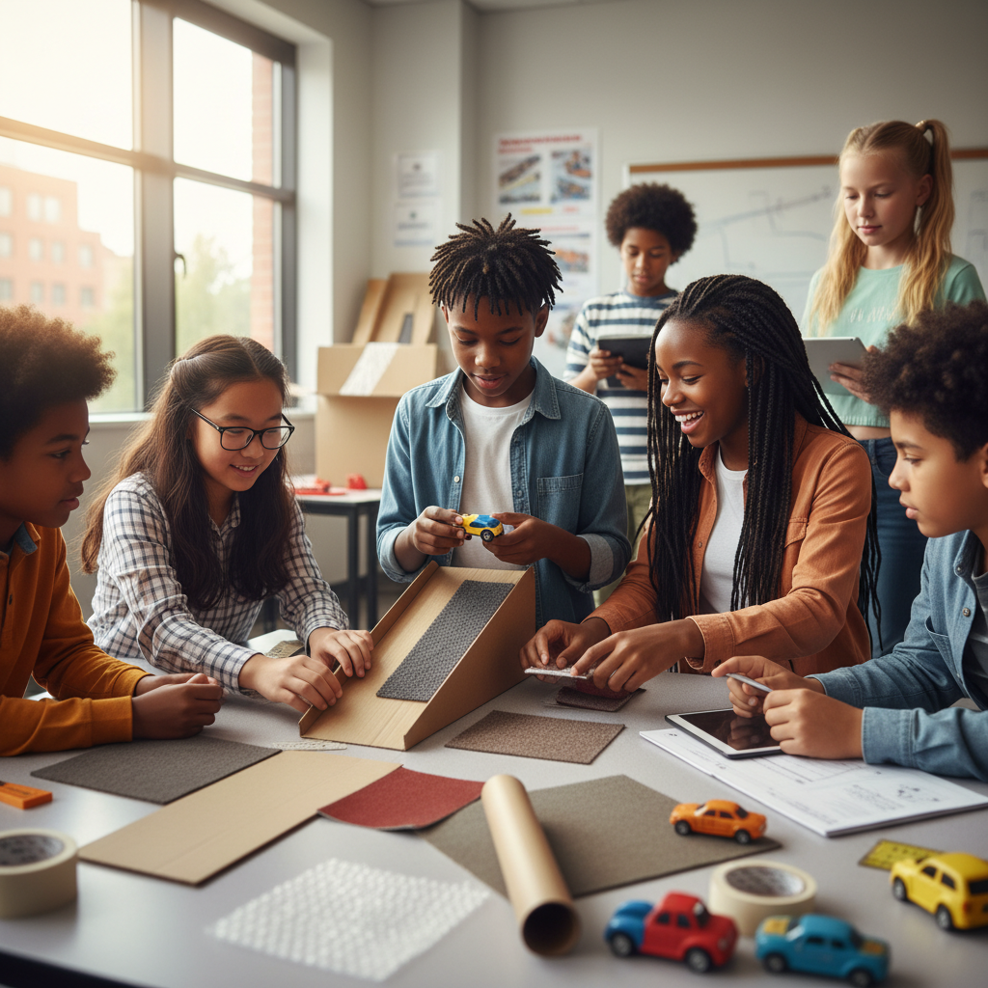
STEM Challenge: Design the Longest Slide
YOUR ENGINEERING MISSION
Engineer a slide or ramp system that keeps an object moving the longest distance possible by minimizing energy lost to friction.
The Challenge:
A toy company wants to design the world's longest toy car track. Your engineering team must maximize the distance a toy car travels by understanding and minimizing energy losses.
Think Like an Engineer:
* What surface materials minimize friction and maximize distance?
* How does the starting height (potential energy) affect how far the car travels?
* What is the relationship between the energy lost to friction and the distance traveled?
REAL CAREER CONNECTION: Mechanical Engineers design systems that manage energy transfer — from car brakes to roller coasters to industrial machinery. They earn $75,000–$125,000/year. The skills you're using TODAY are the same ones they use on the job!
9/9

